Slide 1
A preliminary overview on the
2014 Scrubbing Run II
The scrubbing team, i.e. H. Bartosik, G. Iadarola, K. Li, L. Mether, A. Romano, G. Rumolo, B. Salvant, M. Schenk, T. Argyropoulos, T. Bohl, J. Esteban Muller, G. Kotzian, E. Shaposhnikova, M.Taborelli
Thanks to: G. Arduini, E. Carlier, K. Cornelis, H. Damerau, A. Findlay, S. Gilardoni, B. Goddard, A. Guerrero, S. Hancock, W. Höfle, V. Kain, M. Meddahi, E. Métral, B. Mikulec, G. Papotti, E. Piselli, the SPS OP
… and thanks to the PS complex for the preparation of the challenging beams!!
IEFC, 11 December, 2014

Slide 2
Brief recap of Scrubbing Run I (1/2)
1 full week (week 45) high efficiency scrubbing with very good beam availability (only minor hiccups) and main limitations coming from vacuum in MKP4 and TIDVG (not the arcs)
Scrubbing with both standard 25 ns and (from Wednesday on) doublet beams
Large use of long flat bottom (26 GeV/c) cycle, gradually increasing number of batches injected and moving the dump later in the cycle (as vacuum in TIDVG or MKP4 permitted)
Successfully deployed doublet beam (up to four batches at 26 GeV/c)
  Enhanced electron cloud in high-field non a-C coated regions and none in a-C coated regions and field free regions
No MKE heating, but significant heating on MKP4
  Lower MKP heating (as expected from impedance model) with doublet beam, which allowed scrubbing while recovering MKP4 vacuum

Slide 3
Brief recap of Scrubbing Run I (2/2)
Recovered nominal LHC beam (4 batches 72b) at 450 GeV/c
  Commissioned the new TIDVG with standard 25 ns beam at 450 GeV/c, data taken for thermal response
  Transverse emittances below 3 μm after injection of 4th batch
  Only minor fine tuning yet to be done
Vertical electron cloud instabilities hard to reproduce with Q20 optics!
  Observed only with doublets due to high electron cloud operation
  Standard 25 ns beam was stable even with low vertical chromaticity setting
Important conditioning of both newly installed elements (e.g., MKP4, TIDVG) and pressure in arcs
  Electron cloud suppression with a-C coating experimentally demonstrated in two cells thanks to tests with doublet beams
Scrubbing overall successful so far, ready to move to next step, i.e. inject higher intensities and try acceleration of the doublet beam to 450 GeV/c …

Slide 4
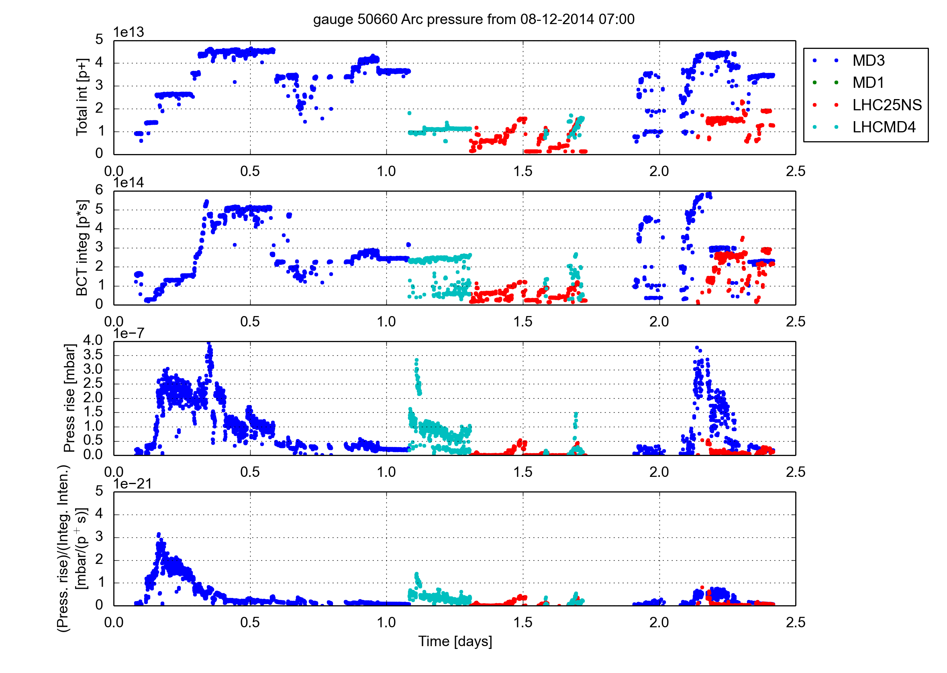
Scrubbing run in week 50: overview
days
MD3: 26.4 s, 26 GeV/c
High intensity 25 ns beam
LHC25NS: 22.8s, 450 GeV/c
LHCMD4: 31s, slow ramp to 450 GeV/c
Monday
  High intensity 25 ns beam (up to 1.9e11 p/b injected) on flat bottom cycle
  Lifetime quite poor
  Instability after injection of 2nd batch
  Emittance blow-up in last part of trains (starting from 2nd batch), especially horizontal
  Clear horizontal instability at end of train
  Intensity scan during the night (but problems in PSB RF)

Slide 5
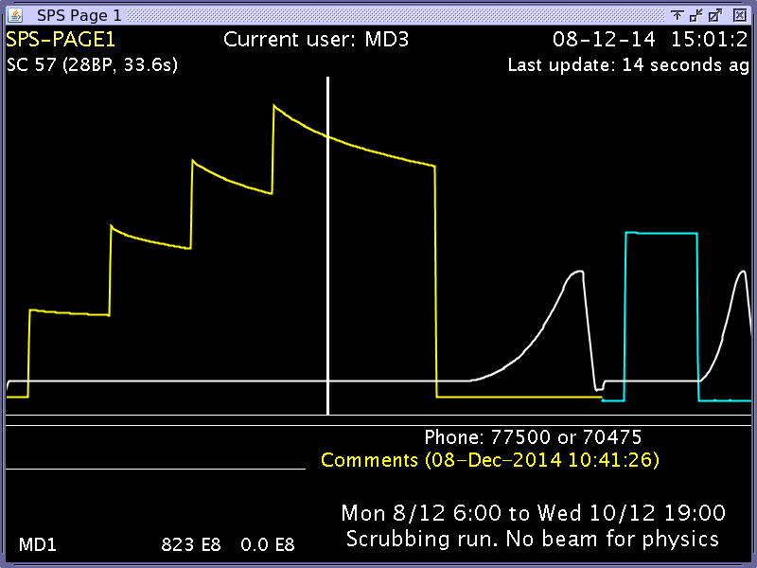
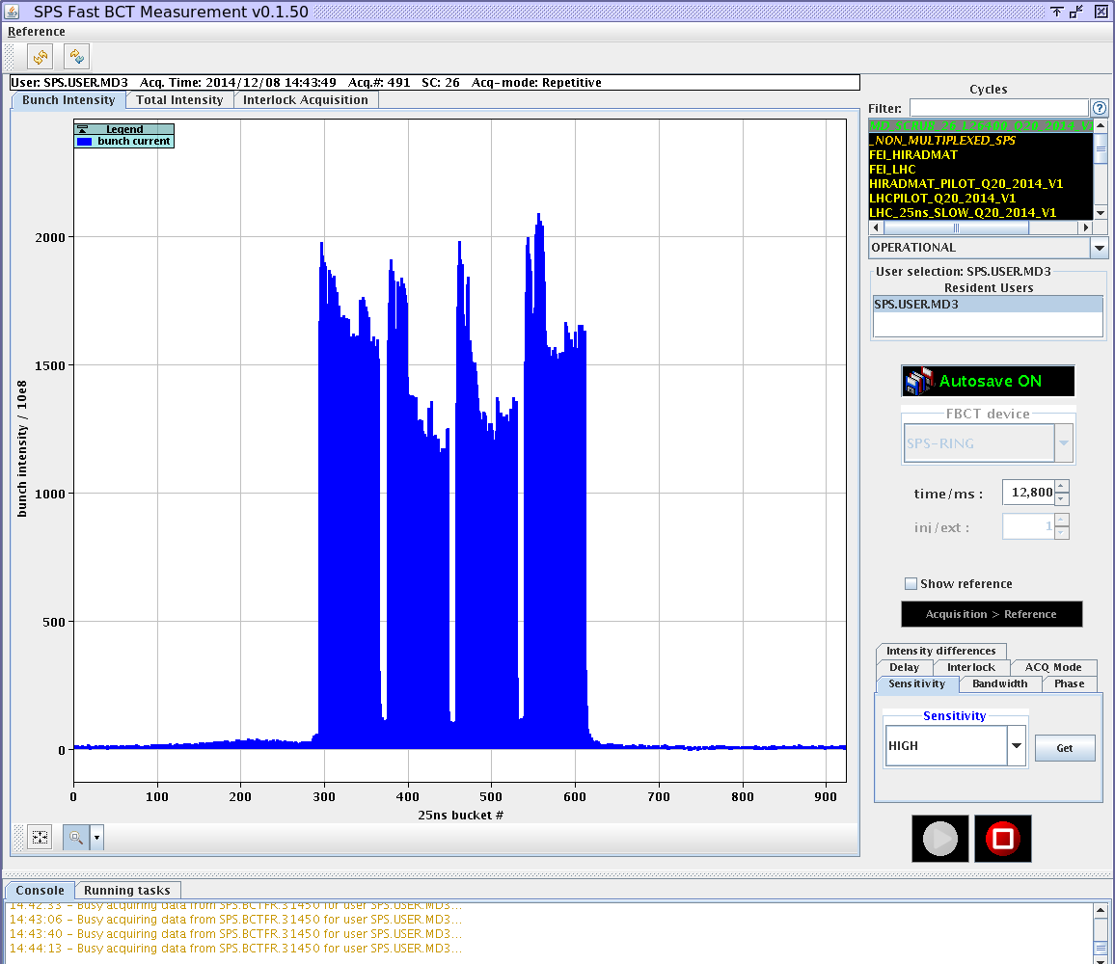
Monday: High intensity LHC beams
Up to 1.9e11 p/b injected into the SPS
Poor lifetime, losses along the batches injected later on

Slide 6
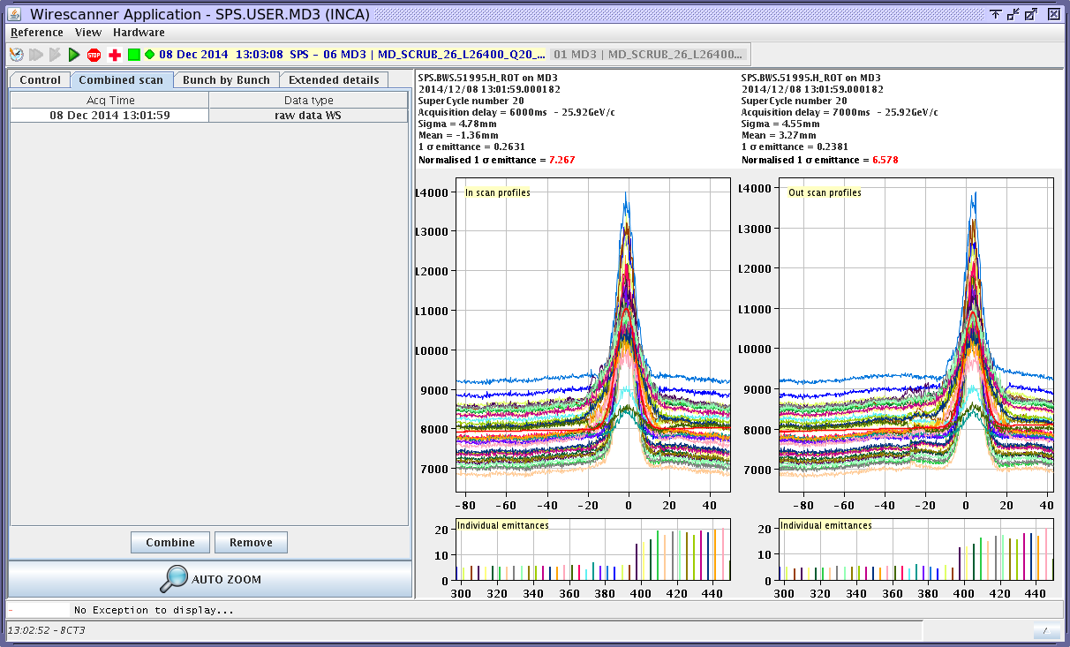
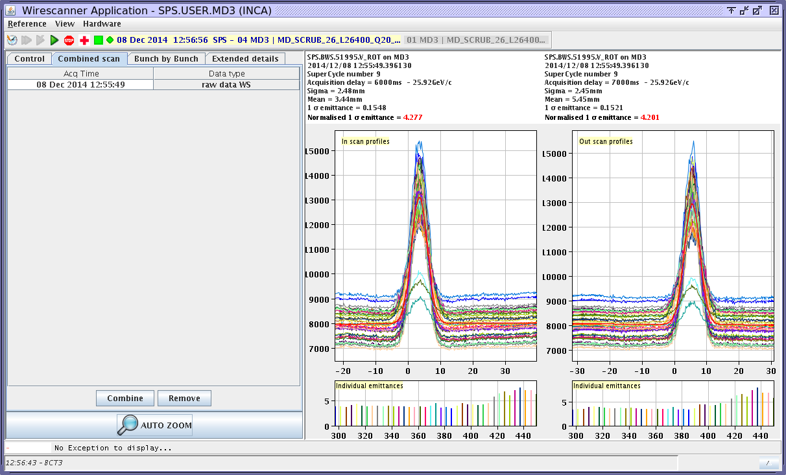
Monday: High intensity LHC beams
Horizontal plane
Vertical plane
Emittance blow up along batches from second one onwards (but already large emittances > 4μm on first batch)

Slide 7
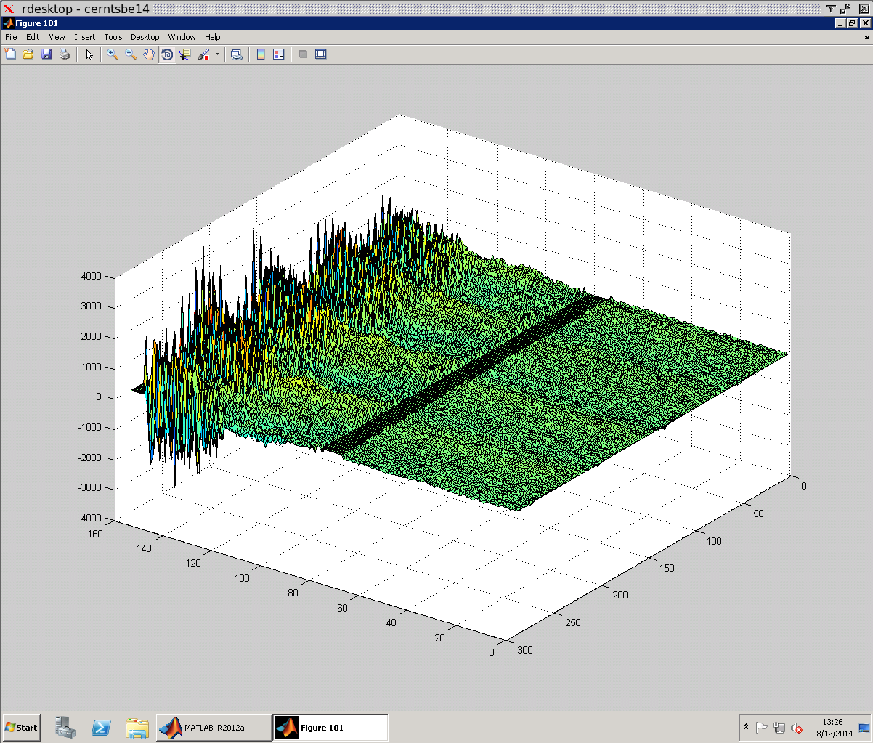
Monday: High intensity LHC beams
Also coherent instabilities clearly detected by the damper pick up at the tail of the batches (in the H plane and from second batch on)

Slide 8
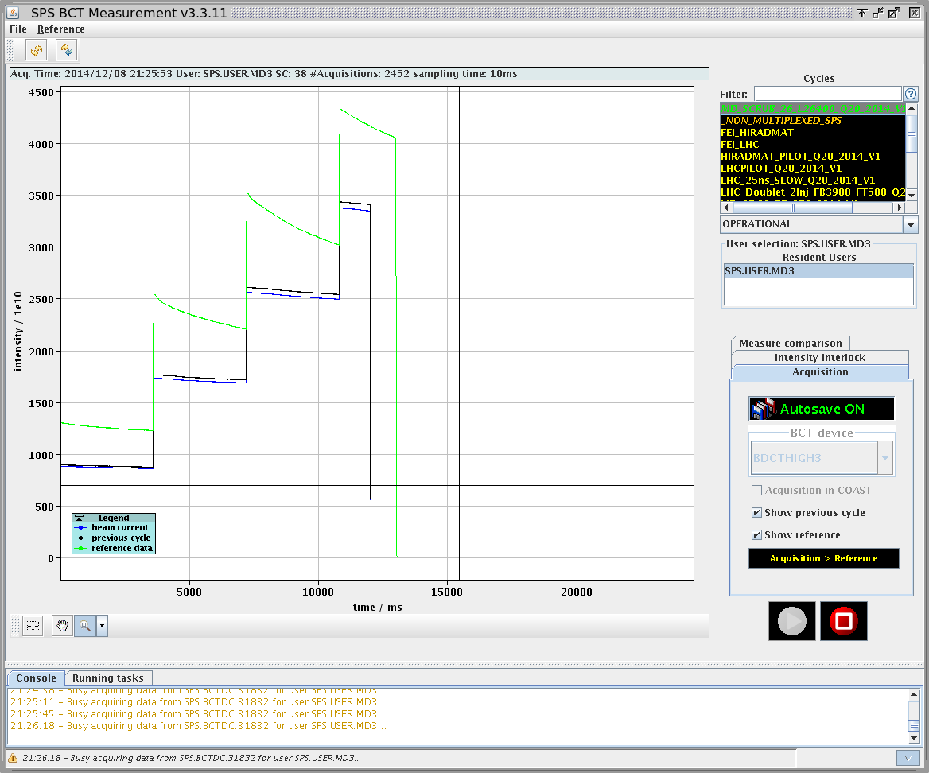
Monday: from high intensity LHC beams back to nominal

Slide 9
Scrubbing run in week 50: overview
days
MD3: 26.4 s, 26 GeV/c
LHCMD4: 31s, slow ramp to 450 GeV/c: doublet
LHC25NS: 22.8s, 450 GeV/c: doublet
Tuesday
  Slow acceleration cycle (initially, cycle setup with 12 bunches)
    Doublet beam (up to 1.9e11 p/b injected)
    Instabilities on the ramp
    High losses on flat bottom and beginning of ramp, increasing significantly with the amount of beam injected
  Doublets also on cycle with nominal LHC filling ramp in parallel
  Maximum intensity on flat top of about 1.4e11 p/doublet with nominal ramp, large emittance growth at the tails of the doublet trains on both cycles
  TT10 quad trip + RF problems in PS during the night

Slide 10
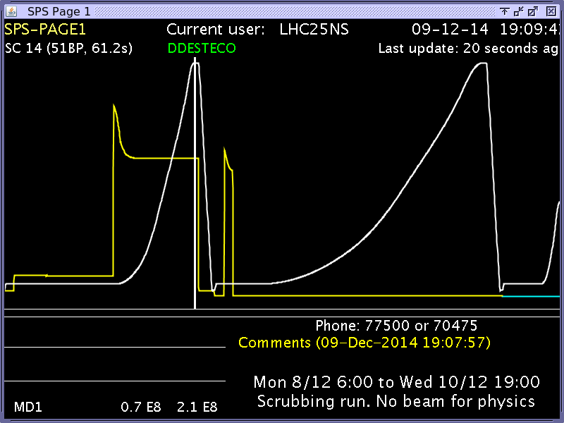
Tuesday: attempt to accelerate doublet on slow and nominal ramp → lots of work yet to be done

Slide 11
Scrubbing run in week 50: overview
days
MD3: 26.4 s, 26 GeV/c
LHCMD4: 31s, slow ramp to 450 GeV/c
LHC25NS: 22.8s, 450 GeV/c
8b+4e
BCMS
LHC25NS: 22.8s, 450 GeV/c
MD3: 26.4 s, 26 GeV/c
High intensity 25 ns beam
Wednesday
  Two parallel cycles
    Long flat bottom cycle for scrubbing with high intensity standard beam
    Nominal LHC filling cycle (with acceleration to 450 GeV/c) to test LHC beam variants
  8b+4e beam on LHC cycle (1.65e11 p/b injected, 1.4e11 p/b at flat top)
    Well behaved electron cloud-wise (as predicted)
    Pressure spike on ZS (impedance?)
    Large losses at beginning of ramp
  BCMS in rather good shape (1.35e11 p/b injected, 1.15e11 p/b at flat top), but still large losses at beginning of ramp

Slide 12
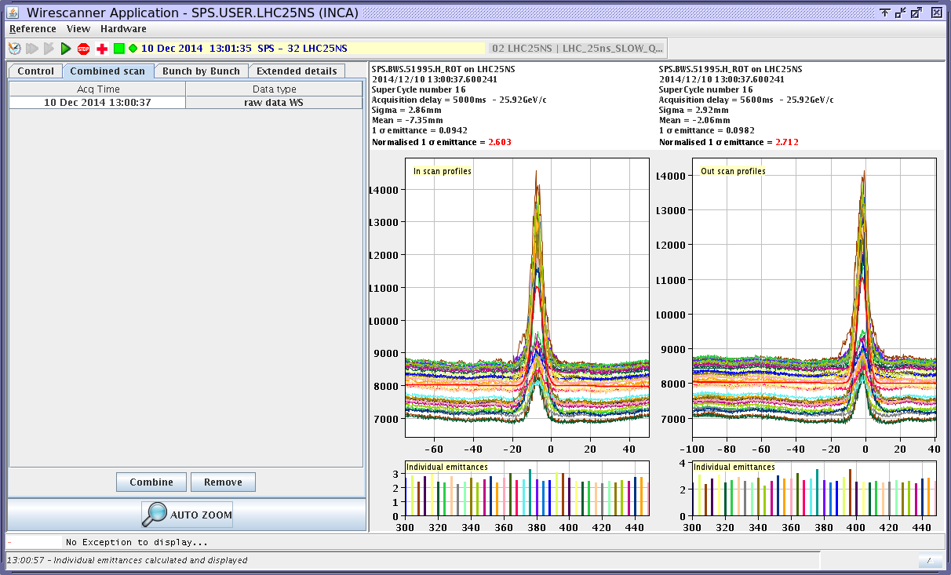
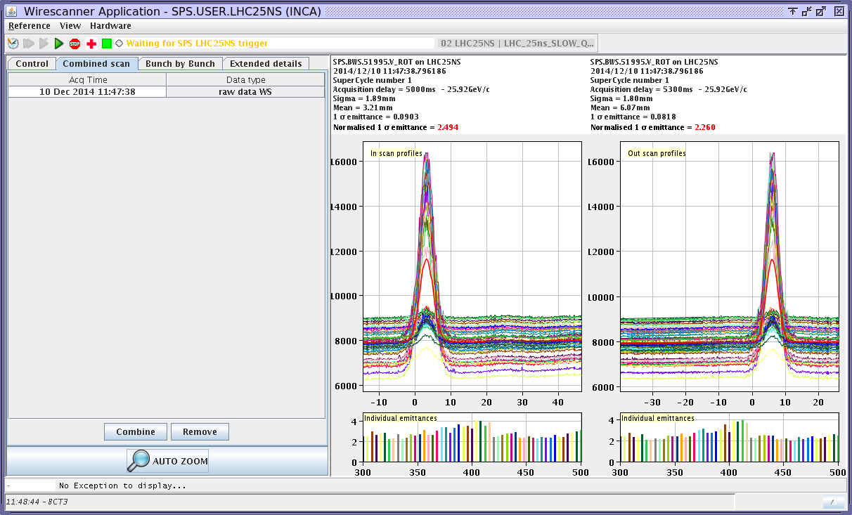
Wednesday: Qualification of LHC beam variants → 8b + 4e
Emittances around 2.5-2.6 μm (bunch-by-bunch after second injection) for an injected intensity of 1.65e11 p/b

Slide 13
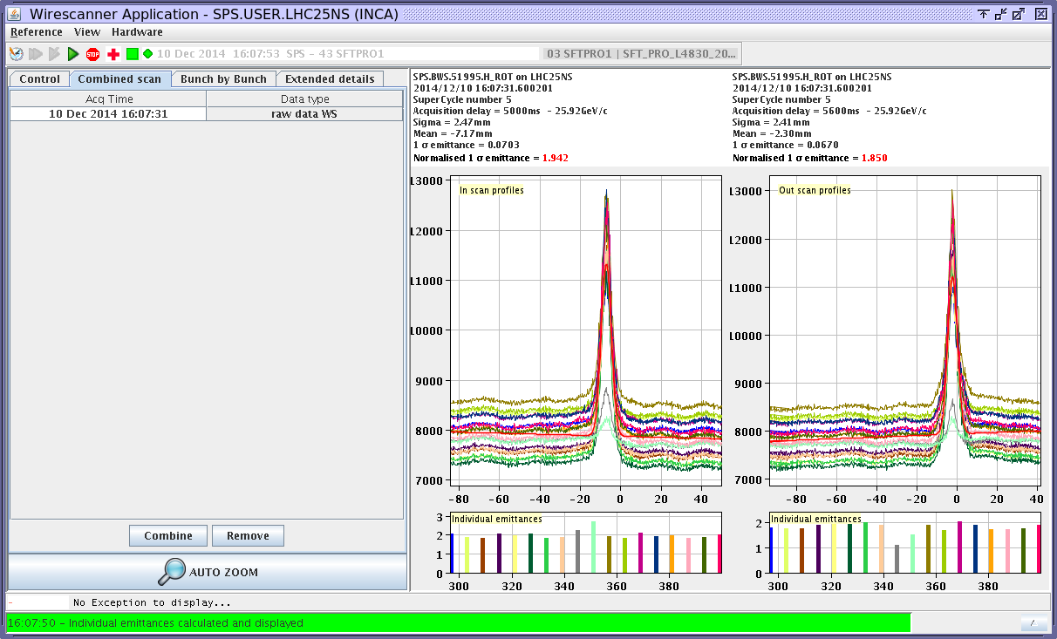
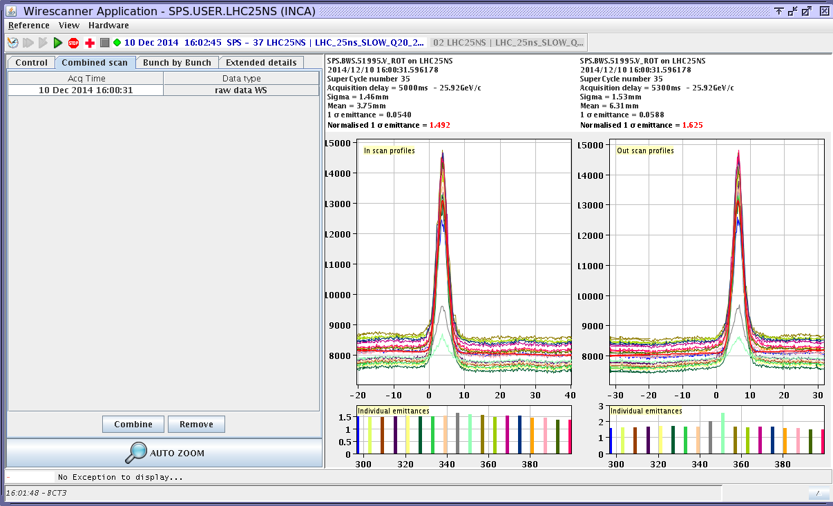
Wednesday: Qualification of LHC beam variants → BCMS
Emittances well below 2.0 μm (bunch-by-bunch) for an injected intensity of 1.35e11 p/b. Seems in a good shape, maybe some optimization needed.

Slide 14
Scrubbing run in week 50: overview on pressure behaviour on an arc gauge (not a-C coated)

Slide 15
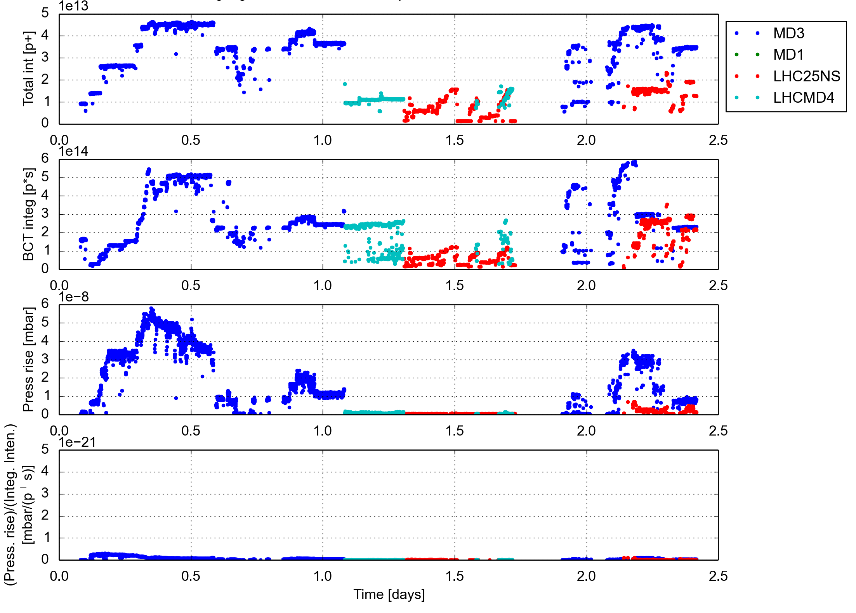
Scrubbing run in week 50: overview on pressure behaviour on an arc gauge (a-C coated)

Slide 16
Summary
High intensity LHC beam (4 batches 72b) at 26 GeV/c
  Strong electron cloud effects
    Poor lifetime, strong emittance blow up at the tails of the batches
    Clear coherent instabilities contributing to the blow up (in spite of the transverse damper and/or high chromaticity)
Doublet beam accelerated to 450 GeV/c
  Many transverse instabilities observed on the slow ramp
  Maximum intensity at flat top limited to 1.4e11 p/doublet on nominal LHC filling ramp, lower on slow cycle (but with 3.6 s injection plateau). Strong emittance blow up.
  In general, beam quality strongly and quickly degraded by electron cloud, but room for improvement if taken on ‘operational’ basis (scrubbing, better set up)
Other LHC beam variants tested
  8b+4e well behaved in terms of electron cloud (as expected), but sparking and outgassing on ZS (impedance problem?), up to three batches accelerated to 450 GeV/c
  BCMS in rather good shape, less electron cloud thanks to shorter batches, up to three batches accelerated to 450 GeV/c.
  For both cases, quite large losses at start of the ramp
More scrubbing accumulated, but much more still needed to hopefully allow stable operation at higher bunch intensities and doublet production…. And answer the question whether we need a-C coating or scrubbing is enough (mid 2015)

Slide 17
2015 draft injector schedule (M. Lamont)

Slide 18
Thank you for your attention!

