Slide 1

Injector MD planning and requests for 2014
https://ab-mgt-md-users.web.cern.ch/ab-mgt-md-users/2014/index.html
Giovanni Rumolo and Hannes Bartosik
Thanks to all MD users, machine supervisors, operators, experts …
MSWG meeting, 30 May 2014

Slide 2
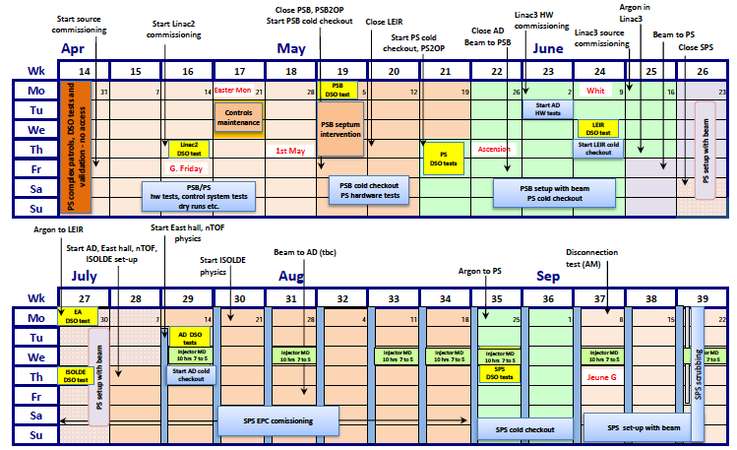
Machine start up and beginning of the MDs
PSB
PS
SPS

Slide 3
Machine start up and beginning of the MDs
Start of MDs @PSB
Start of MDs @PS
70h dedicated MD time @PSB & PS

Slide 4
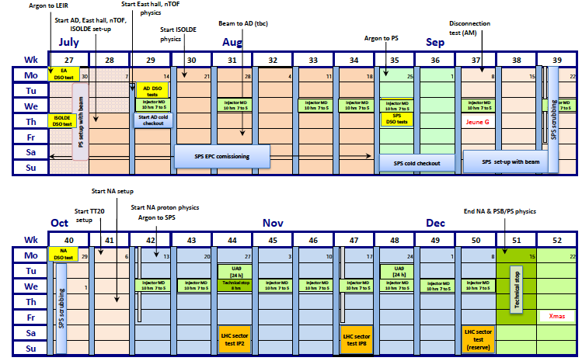
Machine start up and beginning of the MDs
Scrubbing run
Start of MDs @SPS
Scrubbing run
80h dedicated MD time @SPS + 2 x 24h UA9

Slide 5
Organisation of the MDs
Parallel MDs
  Always one cycle available in the PSB and PS mainly during working hours (i.e. working days from 8:00 to 18:00)
    In 2012/13 MD schedule in the PS was based on a doodle among the users → In 2014, weekly meetings will take place on Fridays in the CCC Glassbox with both PSB and PS MD users with primary goal to establish the MD schedule for the following week.
    Schedule published on MD page soon after meeting
  One short MD cycle in parallel with physics also in the SPS
    Is Ar ion cycle set up also considered as an MD?
Dedicated MD blocks
  10h blocks will be available on Wednesdays for dedicated MDs (can we move to 12h to improve efficiency, especially in case of two users?)
    PSB, PS → MD users have priority over physics users, but physics users will be served on a best effort basis
    SPS → FT physics is stopped and MD users share the supercycle

Slide 6
Organisation of the MDs
Cycle creation and naming convention
  No MDs on operational cycles
  To avoid uncontrolled proliferation of machine cycles, MD users will be asked to create and subsequently work on their own cycles (which will be mapped on free timing users at the time of the MD)
    Clone cycle closer to the desired settings and adapt it to MD needs
    Give it a name easy to identify
MD_MDIdentifier_BeamType
Ex. For an MD on electron cloud build up in the PS:
MD_ecloudbu_LHC25
    MD users will be fully responsible for the settings on their own cycles

Slide 7
MD requests: PSB
Parallel MDs with time constraints (or preferences)
  YASP commissioning (B. Mikulec, J.F. Comblin) + Effect of realignment on beam dynamics (E. Benedetto, V. Forte, M. McAteer) → soon after restart
  Longitudinal studies with new RF control (A. Findlay, M. E. Angoletta)
    Longitudinal shaving, C16 blow-up, rebucketing, h1+2 synchro, single batch transfer, other cycle type commissioning
    In Weeks 26, 27, 29-31
  New BTM optics (W. Bartmann, B. Mikulec) → Summer
  Loss identification and studies (M. Kowalska, B. Mikulec) → Summer, based on new BLMs
  Commissioning of new production scheme for LHC beams (A. Findlay, S. Hancock, B. Mikulec, G. Rumolo)
    Increased longitudinal blow up along the ramp and h1+2 transfer to PS
    Should be by August to allow set up in PS and use for the SPS scrubbing run (22 September)
  Test of Finemet cavities (M.E. Angoletta, A. Findlay, M. Paoluzzi)
    Requires half a day access before Week 37
    Will extend over Weeks 38-41
  Injection kicker: kick distribution (T. Fowler, B. Mikulec) → End of Summer
  Optimise BI optics wrt brightness and losses (E. Benedetto, B. Mikulec) → Autumn
  Turn-by-turn linear and nonlinear ring optics studies (M. McAteer, B. Mikulec, J. Sanchez) → After application is ready

Slide 8
MD requests: PSB
Other parallel MDs
  Beam extraction at 160 MeV (W. Bartmann, B. Mikulec, J. Sanchez)
    Relying on new timings for extraction kickers
  Resonance compensation based on measurement of resonance driving terms (G.P. Di Giovanni, M. McAteer)
  Double batch injection of LHC beams into PS with reduced time between batches (K. Hanke)
  Orthogonal injection knobs for PSB-PS injection (K. Hanke)
  Space charge measurements at 50 and 160 MeV (E. Benedetto, V. Forte. M. Kowalska, B. Mikulec)
    Measurements at 50 MeV require a new magnetic cycle
  Effect of chromaticiy correction (E. Benedetto, V. Forte. M. Kowalska, B. Mikulec)
    Tune scans with different chroma settings
  Effect of octupoles on space charge (E. Benedetto, V. Forte)
  Tune shift measurements for impedance model (K. Li, C. Zannini)
    Maybe localization with the new turn-by-turn acquisition in place?
  Hollow bunch creation by injection of sinusoidal offset function into C02 phase loop (A. Findlay, S. Hancock, A. Oeftiger)

Slide 9
MD requests: PSB
MDs affecting the machines downstream
  Effect of changing the integer part of the tune (E. Benedetto, V. Forte. M. Kowalska)
    Requires temporary recabling → dedicated time
  Emittance measurements across injection chain (G. Sterbini, A. Guerrero)
    Calibration of measurements in the PSB (all four rings, WS and SEM)
    Emittance preservation along the injection chain → simultaneous measurements in PS and SPS
Globally for the PSB:
About as many MD type requests as many available weeks for MDs (~25)

Slide 10
MD requests: PS
Parallel MDs (general transverse)
  Kick response measurements (R. Wasef)
  Dispersion and non-linear chromaticity measurements, as for matrix measurements (R. Wasef)
  WP control + nonlinear chromaticity measurement (A. Huschauer)
  Transverse instability @ injection vs. injection error/chromaticity/tune (A. Huschauer)
  Transverse damper (G. Sterbini, A. Blas)
  New injection optics (W. Bartmann)
  Injection error with quadrupolar PU from recabling of ion tune meter or WCM (S. Gilardoni)
  Tune vs kick strength at different dp/p for modelling chromo-geom terms at 2 GeV (R. Wasef, A. Lachaize)
  TMCI at transition for low longitudinal emttances (< 1eVs) (G. Sterbini)
  TT2-TT10 optics (H. Bartosik)
  Compensation of integer with sextupoles/quadrupoles (R. Wasef)
  Emittance preservation across injection chain (G. Sterbini, A. Guerrero)

Slide 11
MD requests: PS
Parallel MDs (general longitudinal)
  Tests of new longitudinal coupled-bunch feedback (H. Damerau, M. Migliorati)
  Coupled bunch instabilities (H. Damerau, L. Ventura)
    With and without 1-turn delay feedback on LHC-type beams
    Using C11 to stabilize beam
  Increased voltage from 40 MHz cavities (C. Rossi, H. Damerau)
  RF manipulations for new exotic beams: 8b+4e, pure batch compression (H. Damerau, S. Hancock)
  Measurements of beam induced voltages in 10 MHz cavities (effect of wide-band feedback gain) (H. Damerau)
  E-cloud from energy loss/phase error (H. Damerau)

Slide 12
MD requests: PS
Parallel MDs (space charge studies + impedance)
  Compensation of 4Qv=1 (R. Wasef)
  Special large H dispersion optics (R. Wasef)
  Direct tune spread measurement with quadrupolar PU (S. Gilardoni)
  Fully coupled optics at injection to induce V dispersion (Y. Papaphilippou)
  Integer tune split of two units (R. Wasef)
  Emittance blow up vs. working point (R. Wasef)
  Efficiency of hollow bunches to mitigate space charge (A. Oeftiger, S. Hancock, R. Wasef) → depends on the results from PSB MDs
  Transverse impedance via Tune shift (N. Biancacci, S. Persichelli)
  Impedance localization (N. Biancacci)
  Longitudinal impedance via quadrupole oscillation (H. Damerau)

Slide 13
MD requests: PS
Parallel MDs with time constraints
  Beta-beating before and after orbit correction pivoting the MUs (R. Wasef, A. Lachaize) → first time after start up
  Flat top electron cloud instability (G. Iadarola, G. Sterbini) → after start up, when electron cloud could be more severe
  Resonance identification before and after orbit correction pivoting the MUs (A. Huschauer) → first time after start up
  General electron cloud measurements with new detectors in MU (C. Yin-Valgren, G. Iadarola, A. Romano) → begin measurements after start up to monitor possible scrubbing effect
  Transfer of larger longitudinal emittance bunches from PSB and benefits (H. Damerau, S. Hancock, PSB) → part of commissioning of the new production scheme for LHC beams
~700h MD request → 18 weeks considering only working hours
Should be o.k. with the 21 weeks potentially available – but MD time has to be used wisely

Slide 14
MD requests: SPS
Parallel MDs (I)
  Test of new SPS BQM (G. Papotti)
  Longitudinal impedance (E. Shaposhnikova et al) → single bunch on Q26, scanning longitudinal emittance in small steps
  Longitudinal space charge (E. Shaposhnikova et al) → need intermediate flat portion
  Microwave instability (E. Shaposhnikova et al)
  Instability threshold due to the S shape of the injected bunch (E. Shaposhnikova et al.)
  Transverse feedback systems (W. Höfle et al):
    Normal damper → commissioning should be done during first two weeks of set up with beam
    High bandwidth damper → MDs will take place mainly during the scrubbing run and then later during MDs with 25 ns or doublet beams

Slide 15
MD requests: SPS
Parallel MDs (II)
  Transverse impedance measurements (H. Bartosik, N. Biancacci, C. Zannini)
    Tune shift vs intensity
    Growth times with chromaticity
    TMCI thresholds
    Impedance localization
  Transverse space charge, explore tune space with ultra-bright beams (H. Bartosik)
  Set up of Ar cycle for 2015 (T. Bohl, D. Manglunki)
  AWAKE synchronization tests (T. Bohl) → initially without beam
  Emittance preservation across injection chain (G. Sterbini, A. Guerrero)

Slide 16
MD requests: SPS
Parallel MDs (II)
  Transverse impedance measurements (H. Bartosik, N. Biancacci, C. Zannini)
    Tune shift vs intensity
    Growth times with chromaticity
    TMCI thresholds
    Impedance localization
  Transverse space charge, explore tune space with ultra-bright beams (H. Bartosik)
  Set up of Ar cycle for 2015 (T. Bohl, D. Manglunki)
  AWAKE synchronization tests (T. Bohl) → initially without beam
  Emittance preservation across injection chain (G. Sterbini, A. Guerrero)
Requested MD time amounts to about 8 weeks (4 days per week – excluding Wednesdays) out of the 9 available weeks

Slide 17
MD requests: SPS
Dedicated MDs
  Optimization of both 50 ns (1.7e11 ppb) and 25 ns (1.2e11 ppb) beams and recovery of 2012 performances (LIU-SPS)
  Recover doublet beam production and set up of acceleration to 450 GeV (H. Bartosik, G. Iadarola, et al)
    Requires new magnetic cycle with slow ramp
  800 MHz commissioning with beam (E. Shaposhnikova et al)
    1 session at beginning of run, 2 after performance recovery
  Coupled bunch instability (E. Shaposhnikova et al) → studies with different numbers of bunches and scanning bunch intensity
  Test of 8b + 4e scheme (LIU-SPS)
  Test controls for the collimation alignment with in-jaw BPMs (collimation team)
  Qualification of sponge materials on UA9 goniometer (UA9 team)
  Emittance growth for crab cavity tests (R. Calaga)

Slide 18
MD requests: SPS
Dedicated MDs
  Optimization of both 50 ns (1.7e11 ppb) and 25 ns (1.2e11 ppb) beams and recovery of 2012 performances (LIU-SPS)
  Recover doublet beam production and set up of acceleration to 450 GeV (H. Bartosik, G. Iadarola, et al)
    Requires new magnetic cycle with slow ramp
  800 MHz commissioning with beam (E. Shaposhnikova et al)
    1 session at beginning of run, 2 after performance recovery
  Coupled bunch instability (E. Shaposhnikova et al) → studies with different numbers of bunches and scanning bunch intensity
  Test of 8b + 4e scheme (LIU-SPS)
  Test controls for the collimation alignment with in-jaw BPMs (collimation team)
  Qualification of sponge materials on UA9 goniometer (UA9 team)
  Emittance growth for crab cavity tests (R. Calaga)
Requested MD time amounts to about 160h out of the presently available 80h (8 x 10h blocks)
Calculated MD time does not include set up of the coasting cycles, which in previous years took at least one shift per cycle
Here prioritization and MD efficiency will be crucial

Slide 19
MD requests: Ion chain
MDs in the different machines
  Dedicated MDs in Linac3 will take place half a day per week from July to December 2014 (D. Küchler)
    Slot can change from week to week (excluded Monday mornings) and is agreed upon in the weekly LEIR supervisor meetings
  MDs in LEIR do not need detailed coordination, because there is usually enough space in the supercycle (PS is the only user)
  No request for PS MDs with ions so far
  SPS requests are mainly Ar cycle set up and for the moment included in parallel MD program (as traditionally was in the past)

Slide 20
Summary
Injector MDs in 2014: key dates
  Foreseen start is on Week 26 (PSB) and Week 29 (PS)
    As from June 20th, 2014, weekly meeting with PSB and PS MD users will take place on Fridays in the Glassbox from 11:00 to 12:00 for MD scheduling
  SPS MDs will start in Week 42 after the scrubbing run (Weeks 39 and 40).
Requests
  A large number of requests received for the different machines
    PSB, PS → Available MD time should be compatible with requests, but need to make good use of MD time
    SPS → Parallel MD time should be compatible with requests, but dedicated MD time is far below the requested time.

